Slide 1
KUREAS-SYS
A System Analysis Example

Slide 2
System Reliability Analysis (Six Steps)
Start KUREAS-SYS by opening KUREAS-SYS.html in a browser
Enter a system name (e.g., CAR_EXAMPLE)
This will be used for the file name when clicking “Save SYS”
An acronym and description is optional
(optional) Load a reliability database file
Create and edit systems, structures, and components (SSCs) that define the key system elements
Define how the system works
Evaluate the system reliability and failure insights

Slide 3
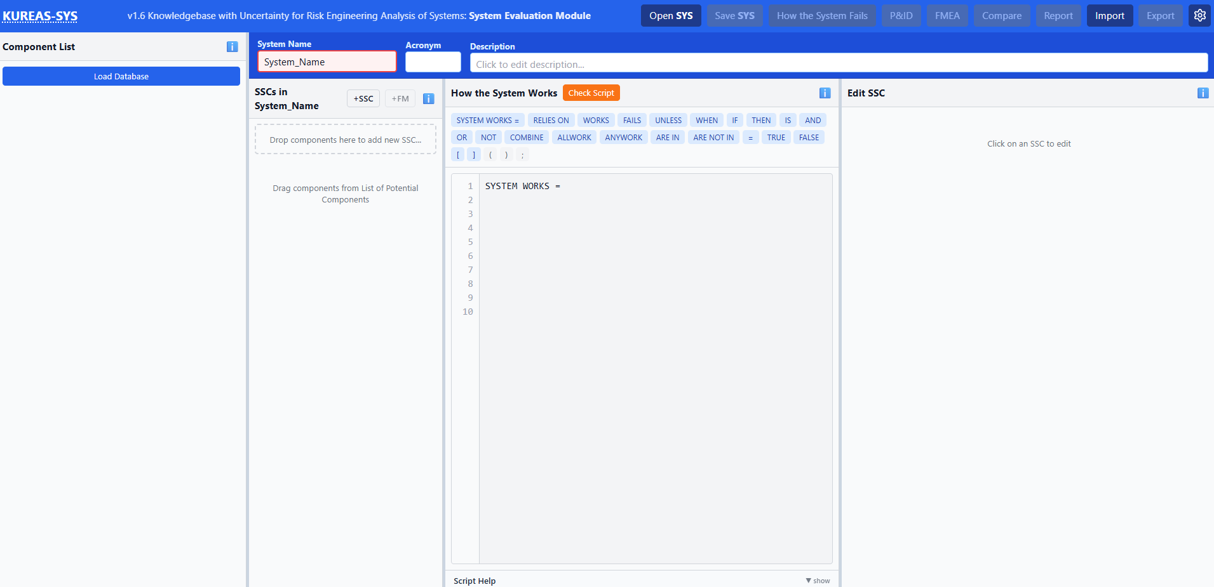
Step Start the Application
1
Start KUREAS-SYS by opening KUREAS-SYS.html in a browser

Slide 4
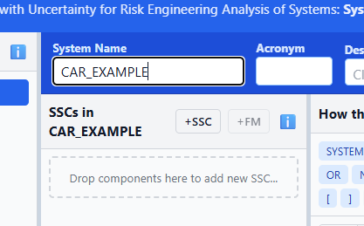
Step System Name
2
Enter a system name
For this example, use “CAR_EXAMPLE”

Slide 5
Step Load Reliability Database
3
A KUREAS Reliability Database is a text-based file (with extension .relDB)that contains reliability information
This could include failure rates and failure probabilities
It has been formatted to be readable by KUREAS-SYS
The format for an element in the .relDB file is
System, SSC Type, Component Type, Failure Mode, Description, Units (“d”=per demand “h”=per hour “hft”=per hour per foot), Distribution Type (Lognormal, Gamma, Beta), Mean, Distribution Shape Parameter, Distribution Scale Parameter or EF if Lognormal, Source ID
A reliability database is not used for this example

Slide 6
Step Create and Edit SSCs
4
SSCs can be created in three ways
Dragging an element from the component list to the SSC area after a reliability database is loaded
Manually using the “+SSC” button
Defining them in the How the System Works (HtSW) script then clicking the “Check Script” button
For example, we will create the SSCs by defining modules in the HtSW script
Think of modules as set of components that need to perform a function for the system
A module is a user-defined label inside square brackets [ ]=
The specifics of the module is to the right of the “=“

Slide 7
Step continued HtSW
4
We will define the following modules and SSC for this example
[Car_Structure] = Car_Body AND Car_Tires;
[Car_Tires] = Tire_FDS AND Tire_FPS AND Tire_BDS AND Tire_BPS;
[Car_Electrical] = Battery AND Starter;
[Car_Fuel] = Fuel_Tank AND Fuel_Pump;
SYSTEM WORKS = Car_Structure AND Car_Tires AND Car_Electrical AND Car_Fuel;
Simply copy this text above into the HtSW script area then click the “Check Script” button
KUREAS-SYS will identify the nine new SSCs; to add them click the “Select All” button then “Add as SSCs”

Slide 8
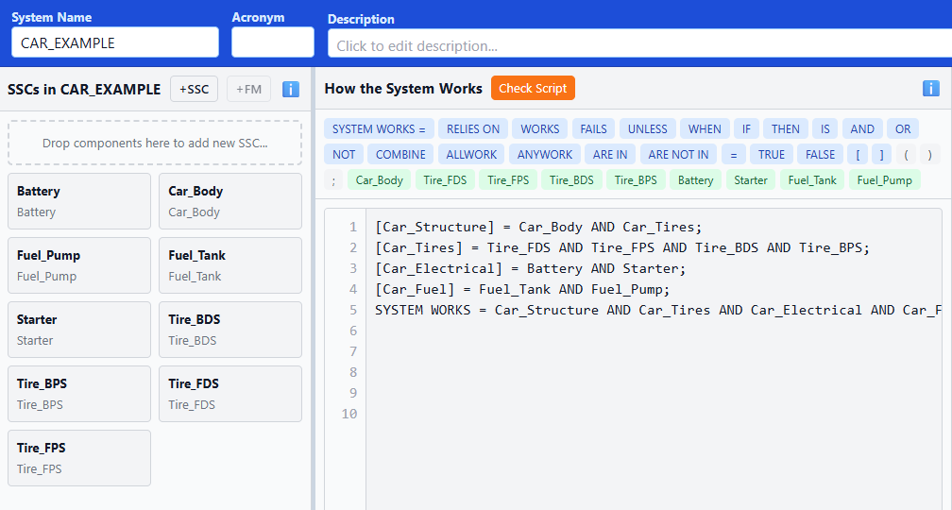
Step continued New SSCs
4
The nine new SSCs will appear in the SSC list
However, we need to assign probabilities to each SSC

Slide 9
Step continued Edit SSC
4
To edit or assign probabilities to an SSC, click the SSC
For example, click the “Battery” SSC
The right-most pane will show the clicked SSC information
Prior to entering probability information, its probability = 0
To enter a description for the SSC, click the description field and enter applicable text
To enter failure information, click “Edit SSC Details”
Enter the SSC information as needed
Provide a SSC type → Electrical
Provide a Component type→ Battery
Provide a Failure Mode → Click the “+FM” button

Slide 10
Step continued Edit Failure Mode
4
Enter the applicable info when editing a Failure Mode
Failure Mode → FTO
FM Description → Fails to Operate
Evaluation Type → Failure Probability
“Failure Probability” = a quantified failure model
“Qualitative” = low, medium, or high with user-specified values
“Screened Out” = removed from consideration, but kept in the file for transparency or quality assurance purposes
“Link to System Evaluation File” = use the overall system failure probability from another KUREAS-SYS model

Slide 11
Step continued Failure Probability
4
For the Evaluation Type of “Failure Probability,” options include
Probability of Failure: specify the mean and distribution
Demand (Binomial): specify the probability of failure on demand, the number of demands, and the distribution
Fails While Operating (Poisson): specify the failure rate (per hour), the operational mission time (in hours), and the distribution
Fails in Standby: specify the failure rate (per hour), the inspection test interval (in hours), and the distribution
Fails While Operating w/ Repair: specify the failure rate (per hour), the operational mission time (in hours), the repair time (in hours), and the distribution
Logic T/F Flag: specify True, False, or Ignore
For this example, simply set all SSCs with a FTO failure mode and a failure probability of 0.02
Now is probably a good time to click the “Save SYS” button
Note that a SSC can have multiple failure modes (this example only has one failure mode for each SSC)

Slide 12
Step Define How the System Works
5
Since we already defined HtSW in Step 4 when creating the SSC, we can skip this step
The HtSW script is a depiction of how the system (in this case, a car) is designed to function
The HtSW script has keywords such as
X AND Y, both X and Y have to work for the system to work
X OR Y, either X or Y working results in the system working
NOT Y, a negation (Y is not working)
COMBINE(2, X Y Z), any combination of 2 of X Y or Z working causes the system to work

Slide 13
Step Evaluate System Reliability
6
Once the system and SSCs are defined, click the “How the System Fails” button
KUREAS-SYS will now
Evaluate the HtSW script to create an equivalent fault tree
Generate cut sets for that fault tree
Quantify the cut sets
Calculate the importance measures
The failure logic and failure insights will be displayed
Don’t forget to save your work by clicking “Save SYS”

Slide 14
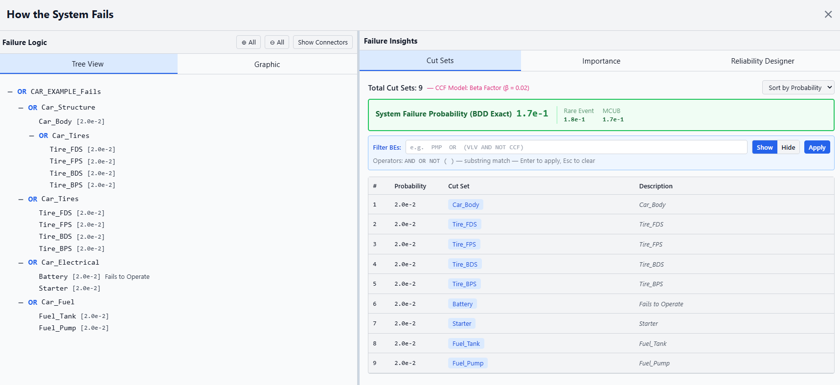
Step continued HtSF Screen
6

Slide 15

Step continued Results
6
The Failure Logic is a tree view of the fault tree
The Graphic is a simple fault tree
For a better fault tree graphic, consider Exporting the project to a KUREAS-FTL file (.KNOW_FTL)
The Cut Sets are listed in order of probability
Use the filter criteria to find specific items of interest
The default quantification is controlled through settings
The Importance shows a plot and table of important measures
The Reliability Designer allows you to modify SSC failure probabilities up/down to see their impact on the system

Slide 16
Optional
Some of the optional things to consider
P&ID: A piping and instrumentation diagram editor
FMEA: Identify and store the failure modes and effects related to each SSC
Compare: Compare two different system analysis configuration files
Report: A comprehensive report preview and Word file
Import: Import basic events from a KUREAS-FTL file
Export: Export
Report info (.KNOW_RPT) for use in KUREAS-REPORT
Failure results (.KNOW_FTL) for use in KUREAS-FTL and KUREAS-SEQ
The SSCs into a new reliability database file (.relDB)
The SSCs into a FMEA database file (.fmeaDB)
Settings: GUI and Project level settings

